Slide 1


Slide 2
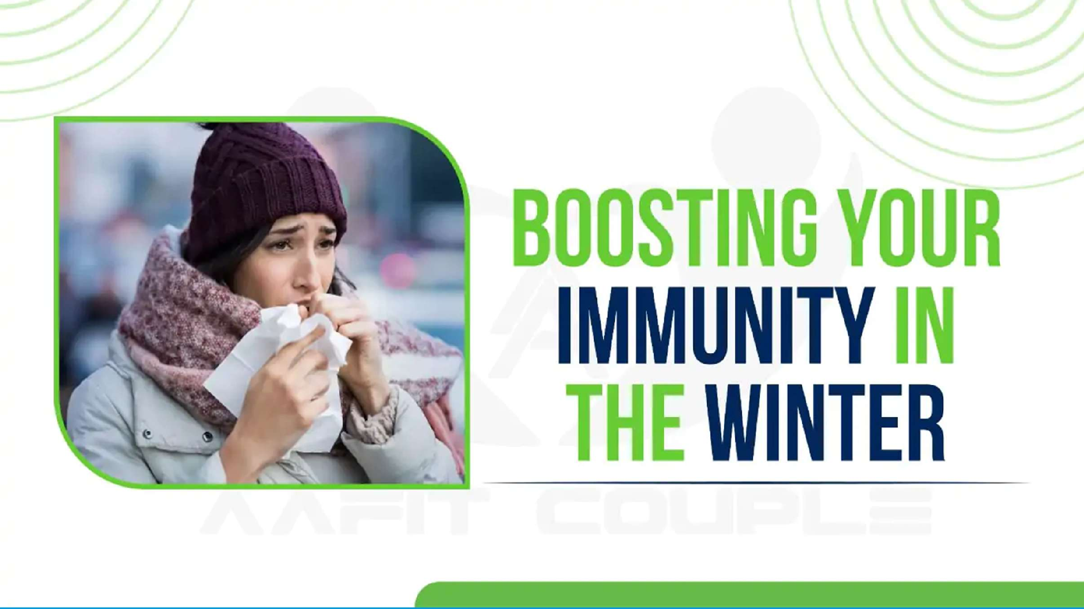
THE IMPORTANCE OF WINTER FOR HUMAN HEALTH

Slide 3
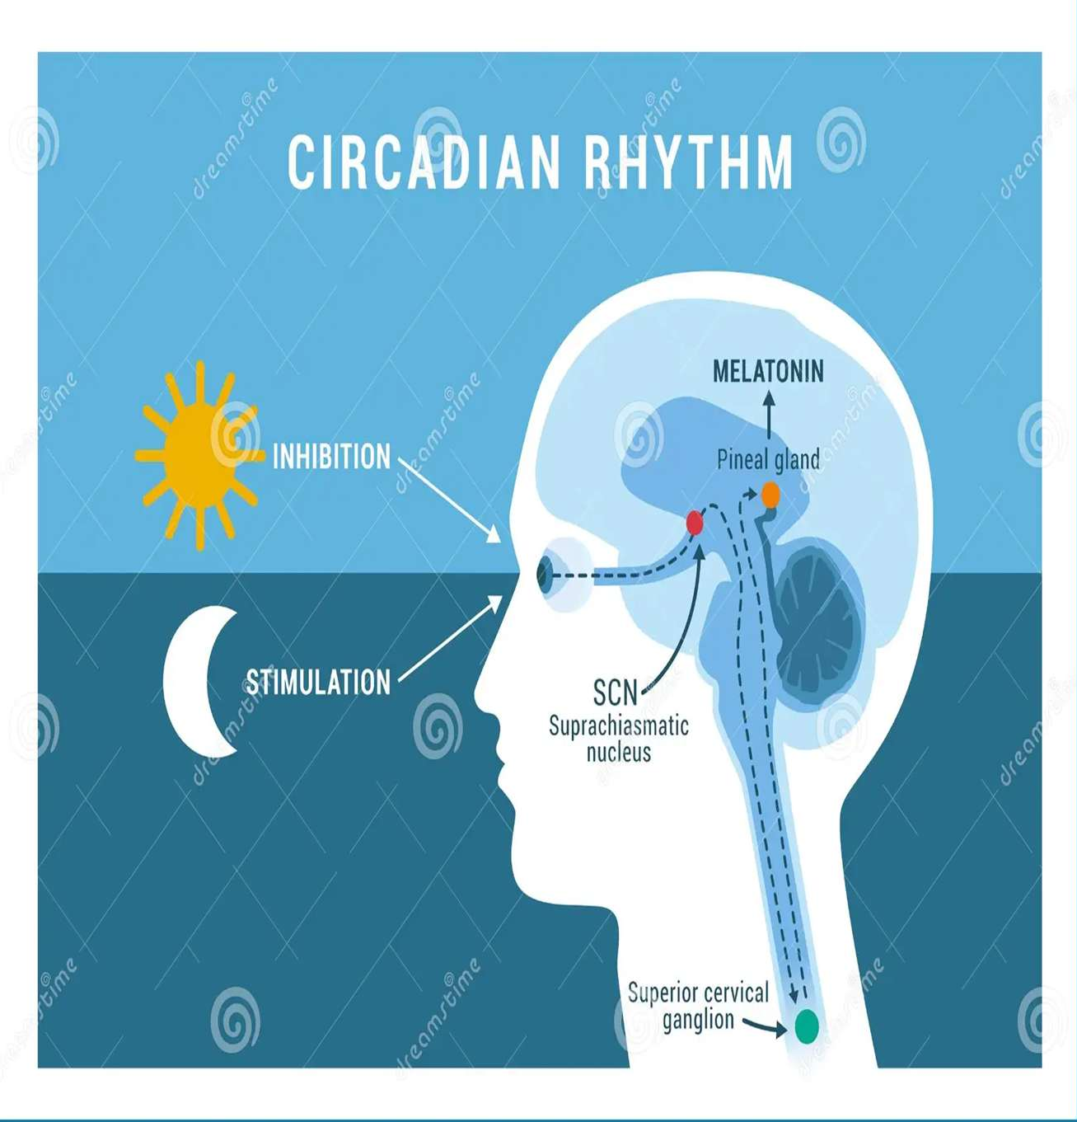
LATE SUNRISE AUR EARLY SUNSET
LESS SUNLIGHT MEANS LESS MELATONIN CATROL
EFFECT ON MOOD OR ENERGY
THE BODY CLOCK GETS DELAYED

Slide 4

REST AND RECOVERY PHASE IN WINTER
THE BODY’S NATURAL SLODOWN
SLEEP QUALITY BECOMES BETTER
NUTRITION AND WARM FOODS

Slide 5
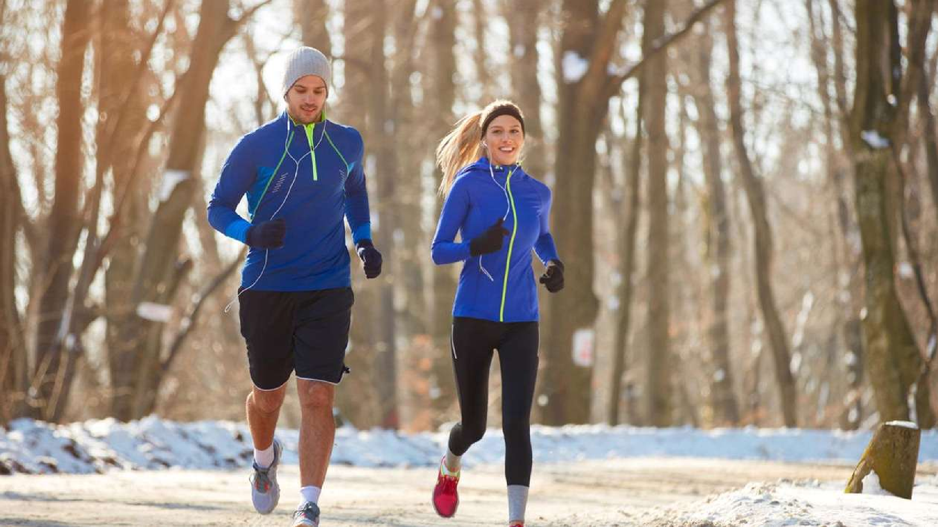
IMMUNITY ENHANCEMENT IN WINTER
HEALTHY AND WARM FOOD
SUNLIGHT EXPOSURE
REGULAR EXERCISE
PROPER REST AND SLEEP

Slide 6
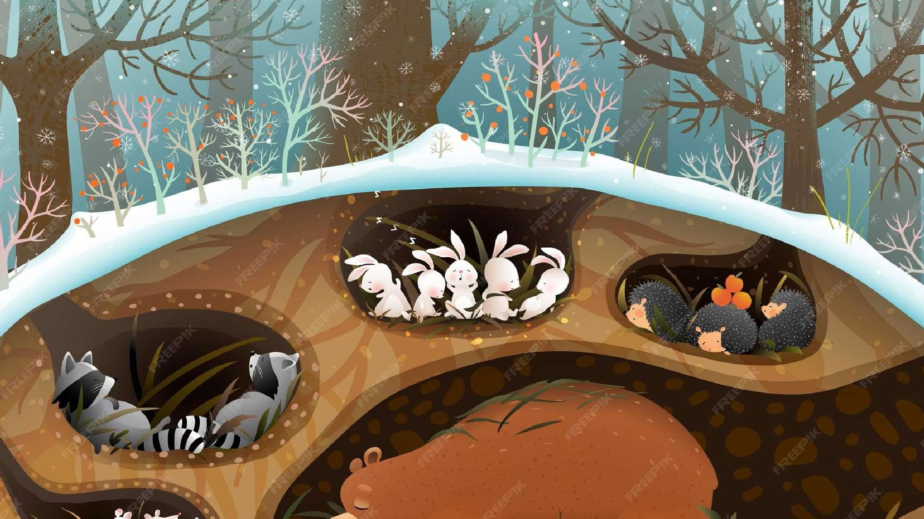
WHY ANIMALS HIBERNATE IN WINTER

Slide 7
CONCLUSION

